Slide 1
Prediction Of Oil Price
Present by team 4
Team members
Sanket Raut
Mangalparthy Mahesh
R.Vishnu Vardhan Reddy
S Muhaideen Abdul Kader
D.Vikram Kanth
Mohamed Rehnaz Ashraf
Date : 27/06/2023

Slide 2
Objective : Oil prices are often influenced by factors outside of immediate information, which makes it difficult to predict them accurately. These prices can have a significant impact on the economy. Our model aims to analyze the patterns in oil prices to assist customers and businesses in making informed decisions.

Slide 3
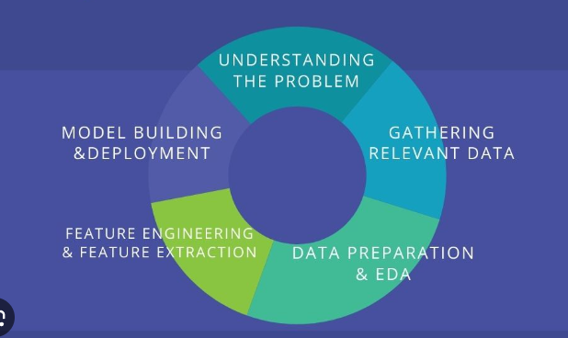
Project Architecture / Project Flow

Slide 4
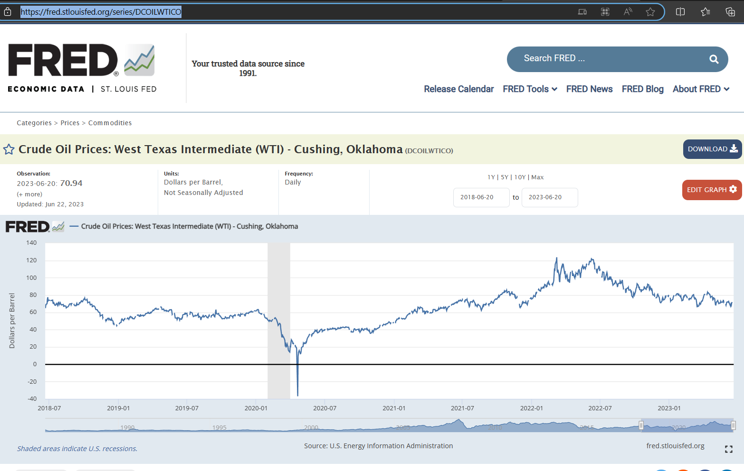
Dataset
Source: U.S. Energy Information Administration
Link
Crude Oil Prices: West Texas Intermediate (WTI) - Cushing, Oklahoma (DCOILWTICO) | FRED | St. Louis Fed (stlouisfed.org)

Slide 5
Exploratory Data Analysis (EDA)

Slide 6
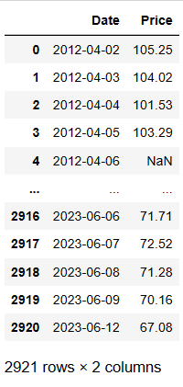
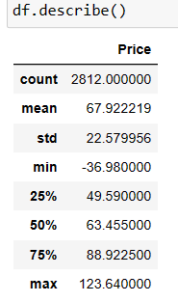
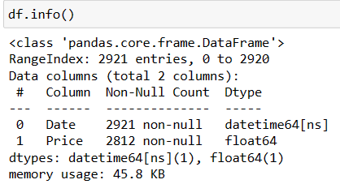
In this dataset
The dataset consists of 2 columns: "Date" and "Price".
The dataset contains 2,921 entries.
The "Date" column is of the datetime data type.
The "Price" column is of the float data type.
The "Price" column has 2,812 non-null values, indicating some missing data.
The average price in the dataset is approximately 67.92.
The standard deviation of the prices is around 22.58.
The minimum price recorded in the dataset is 36.98.
The 25th percentile of prices is 49.59, meaning 25% of the prices are below this value.
The median price is 63.45, indicating that 50% of the prices are below this value.
The 75th percentile of prices is 88.92, meaning 75% of the prices are below this value.
The maximum price recorded in the dataset is 123.64.

Slide 7
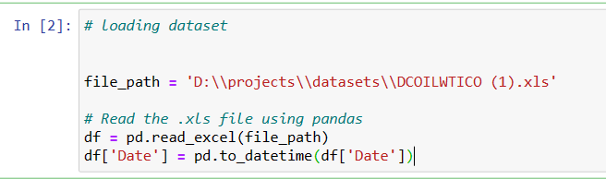
Feature Engineering
Assigns the converted datetime values back to the 'Date' column in the DataFrame.
Conversion to datetime format allows for easier manipulation and analysis of dates.
The code prepares the dataset for further analysis and manipulation by ensuring the 'Date' column is treated as a date/time data type.

Slide 8
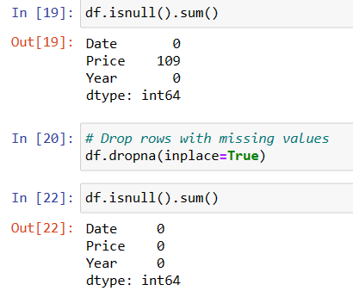
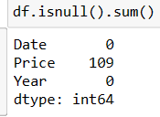
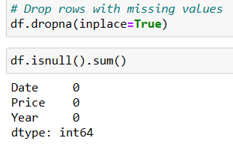
Handle Missing Data
Before handling missing values:
The "Date" variable has no missing values.
The "Price" variable has 109 missing values.
After handling missing values:
Both the "Date" and "Price" variables have no missing values.
The "Year" variable also has no missing values.
Total number of values: 2921 and Number of null values in the "Price" variable: 109
Percentage of null values in the "Price" variable: (109 / 2921) * 100 = 3.73%
approximately 3.73% of the values in the "Price" variable are null.

Slide 9
Library
Pandas
Pandas is used for data manipulation, indexing, filtering, updating, and preprocessing
It allows operations such as data alignment, column selection, visualization, and prioritized splitting.
Matplotlib
Matplotlib is used in Python for generating graphics and visualizations, including plots,
charts, and figures.
It supports various types of plots, including bar graphs, line graphs, pie charts,
scatter plots, histograms, and more.
Seaborn
Seaborn is used for data visualization, data exploration, and chart customization
in data science.
It enables dynamic updating, exploratory development, partitioning usage, and the
creation of various plots like box plots, violin plots, swarm plots, and others.
Scikit-learn (sklearn)
Scikit-learn is a powerful machine learning library used for various tasks like
classification, regression, clustering, and dimensionality reduction.
It provides tools for model selection, preprocessing, evaluation, and scoring, along
with a wide range of machine learning algorithms and utilities.

Slide 10
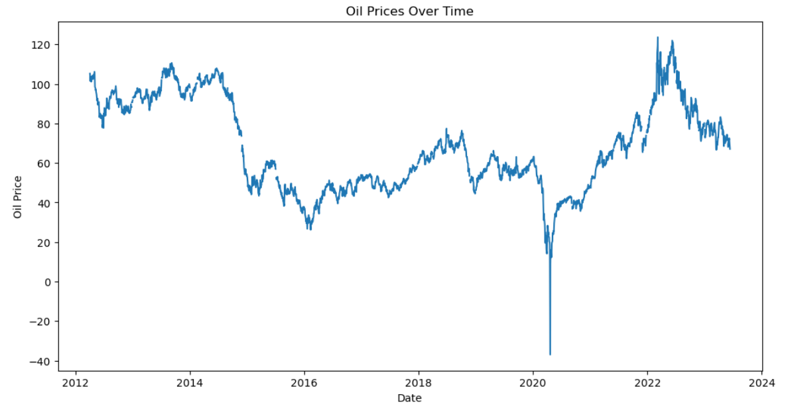
Visualization [ Trend ]
Oil prices were relatively high, ranging between 100 to 120 units, in 2012.
Subsequently, there was a consistent downward trend in oil prices.
In the first month of 2020, there was a sharp decline, with oil prices hitting a low point of around 30 units.
However, in 2023, there has been an upward trend, suggesting a recent increase in oil prices.

Slide 11
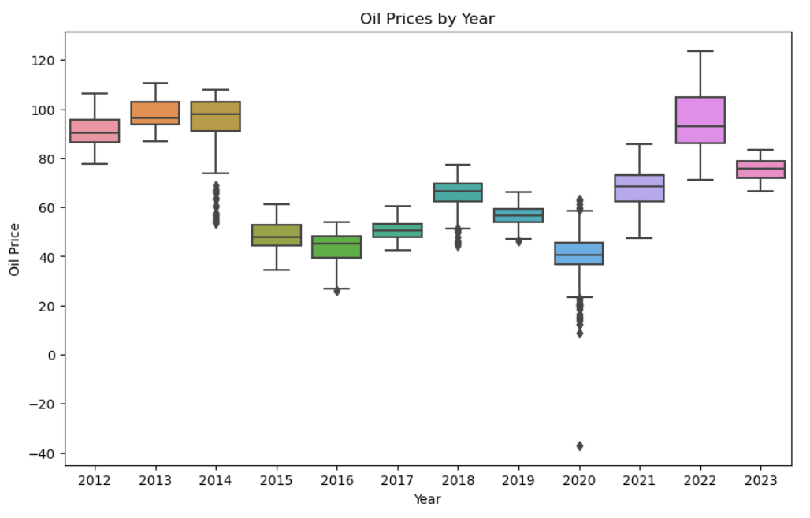
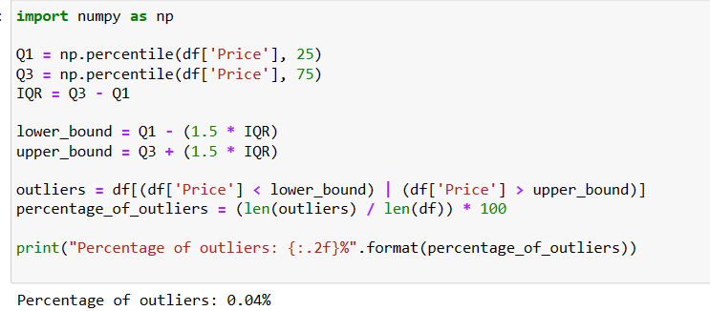
Outlier’s
Outlier Percentage:
After analyzing the data, it has been determined that only 0.04% of the data points are considered outliers.
Definition of Outliers:
Outliers are data points that significantly deviate from the rest of the dataset. They can be unusually high or low values compared to the majority of the data.
Impact on Data:
Since the percentage of outliers is extremely low (0.04%), their presence has a minimal effect on the overall dataset.

Slide 12
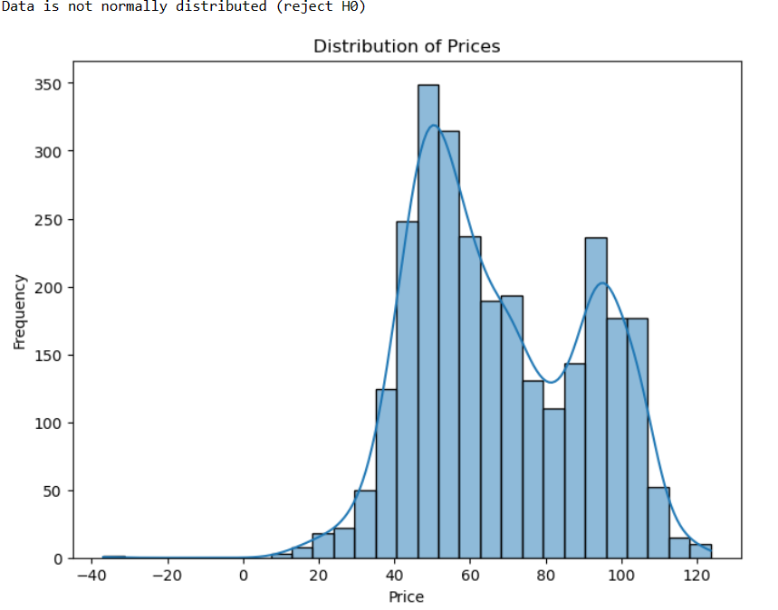
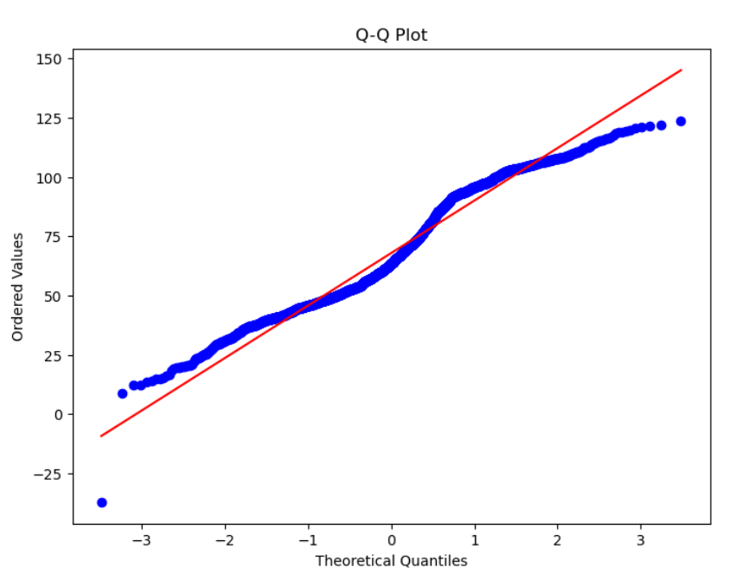
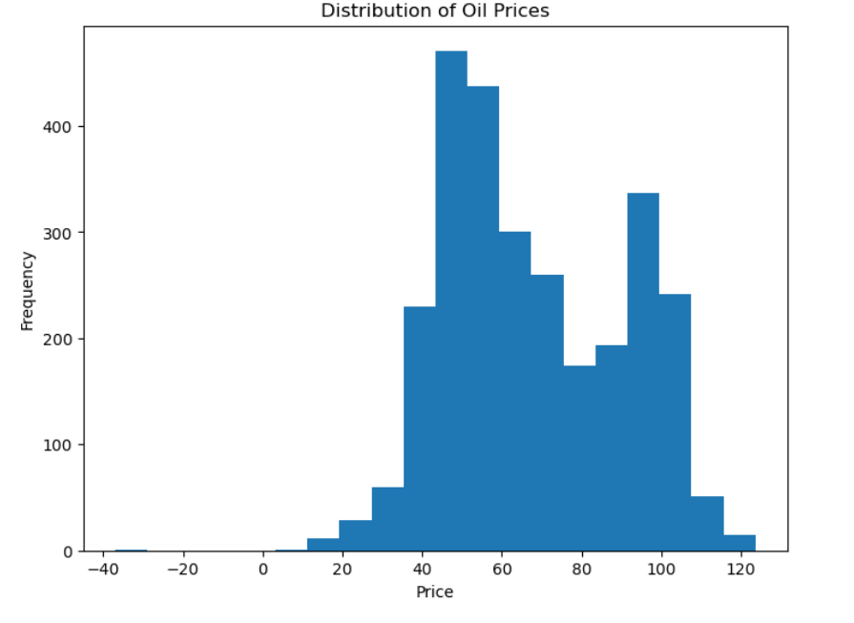
Distribution of data
The dataset is not normally distributed, as indicated by the non-linear trend in the Q-Q plot, deviating from the expected line for a normal distribution.

Slide 13
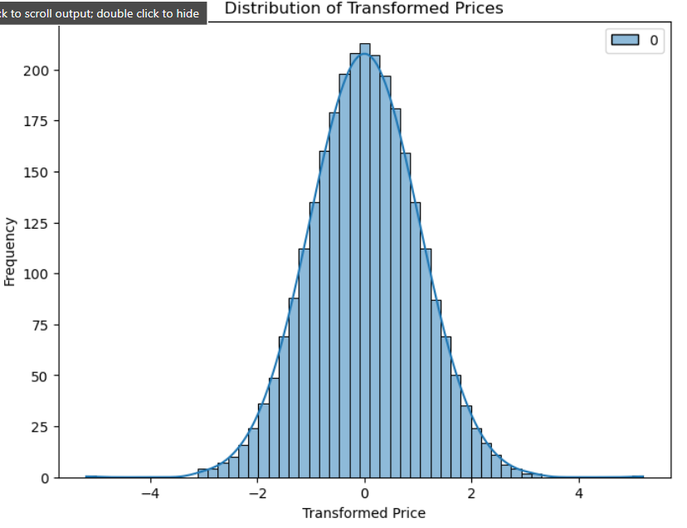
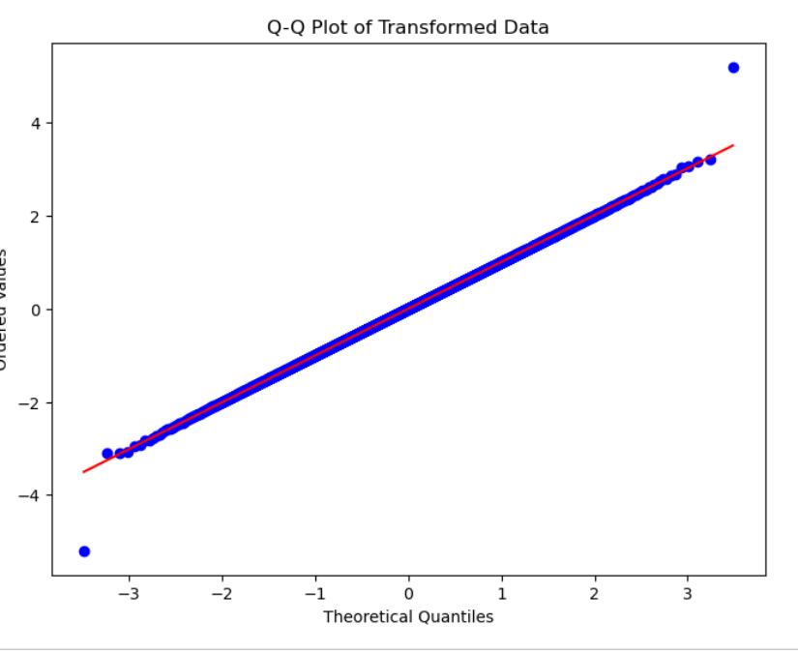
Normal distribution
n
Use scikit-learn's QuantileTransformer to transform 'Price' column.
Reshape 'Price' column to match the input format.
Transformed data now follows a normal distribution.
Use transformed data for analysis or modeling, considering normal distribution assumptions.
Apply quantile transformation using fit_transform method.

Slide 14
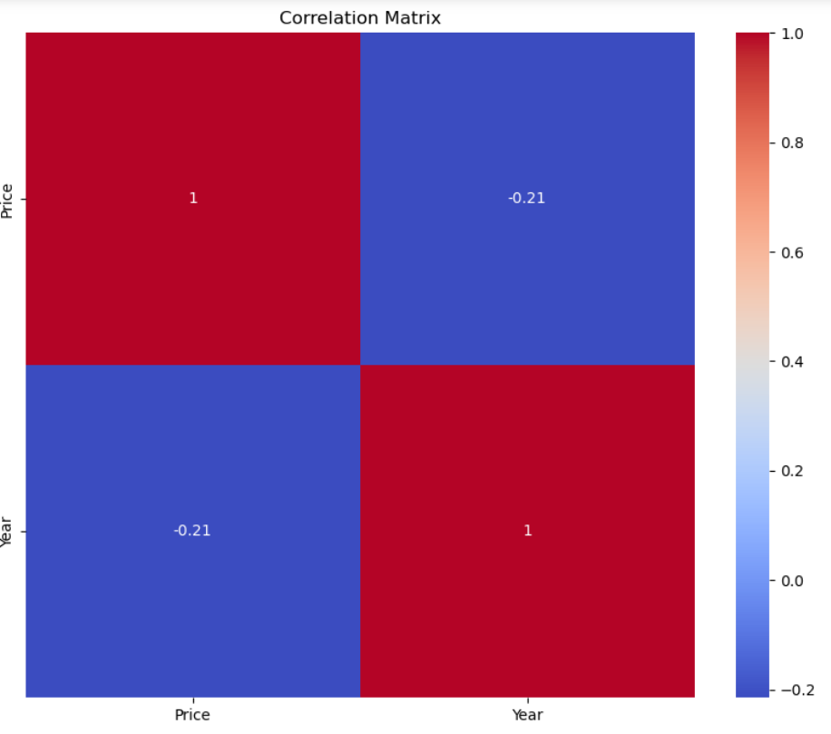
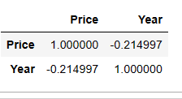
Correlation
Weak negative correlation (-0.215) between 'Price' and 'Year’.
'Price' tends to decrease slightly as 'Year' increases.
Correlation is not strong or significant.
Correlation does not imply causation.
Visualization helps identify potential relationships and patterns.

Slide 15
EDA (Exploratory Data Analysis) was performed on the dataset.
Missing or null values in the dataset were identified and replaced with appropriate values.
Outliers in the data were detected, but they were determined to have no significant impact on the dataset, so they were retained.
The data was transformed to achieve a normal distribution.
With these steps completed, the dataset is now prepared and ready for further processing or analysis.
.

Slide 16
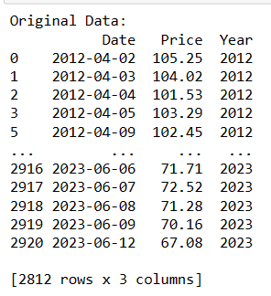
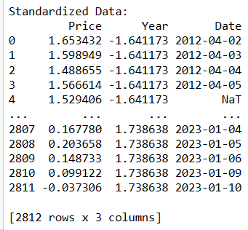
Standardization of data
StandardScaler from sklearn helps us make data comparable by transforming it to have a mean of 0 and a standard deviation of 1.
It preserves the relative differences between values while bringing them to a common scale, which is useful when dealing with features of different units or scales.
Additionally, it allows us to scale the data within a specific range, like 0 to 1, making it suitable for certain algorithms or easier to interpret.
Overall, the standardized data provides a consistent scale for 'Price' and 'Year', making it easier to compare and analyze these variables. It can help identify relationships and patterns between them, such as the impact of different years on prices.

Slide 17
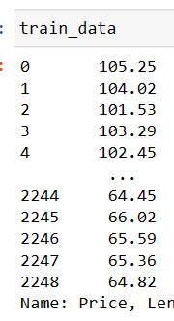
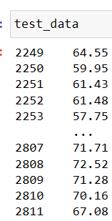
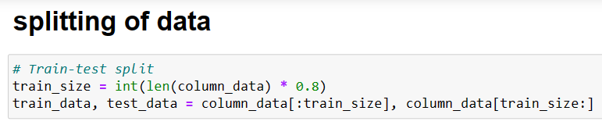
Preparation of data
"We use 80 percent of the data for training the model, and the remaining 20 percent is used for testing the model's performance."
The data is split into two sets: 80 percent of the data is used for training, and 20 percent is reserved for testing.
The model is trained on the training data to learn patterns and relationships within the data, and then it is evaluated on the testing data to measure its performance and see how well it generalizes to unseen data.

Slide 18

Model Fitting

Slide 19
Model’s
Long Short-Term Memory [LSTM ]
2) Support Vector Regression [ SVR ]
3) Gradient boosting
4) Holtwinters
5) Autoregressive Integrated Moving Average [ ARIMA ]
6) Linear Regrassion

Slide 20
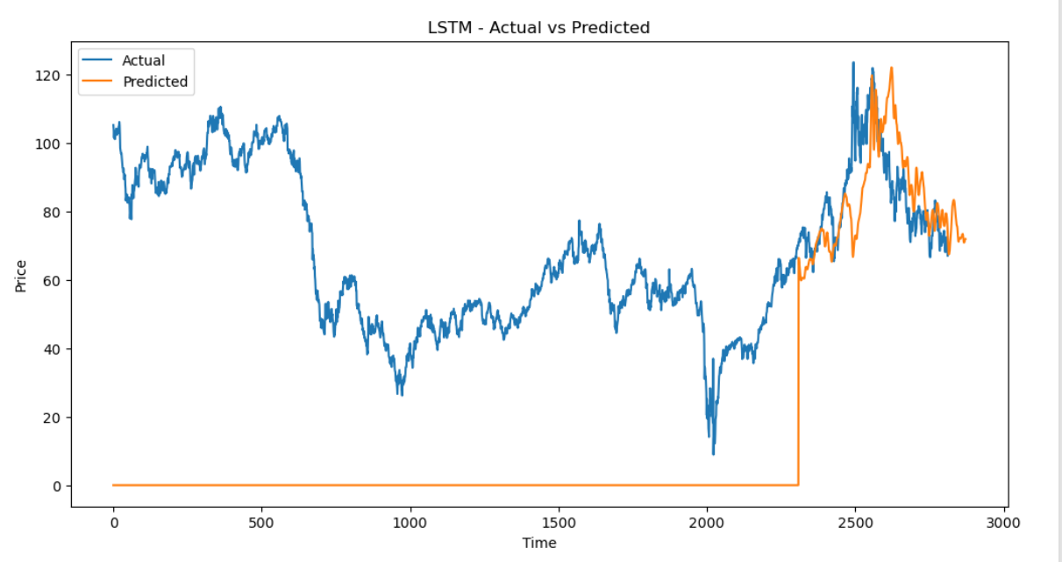
Model LSTM

Slide 21
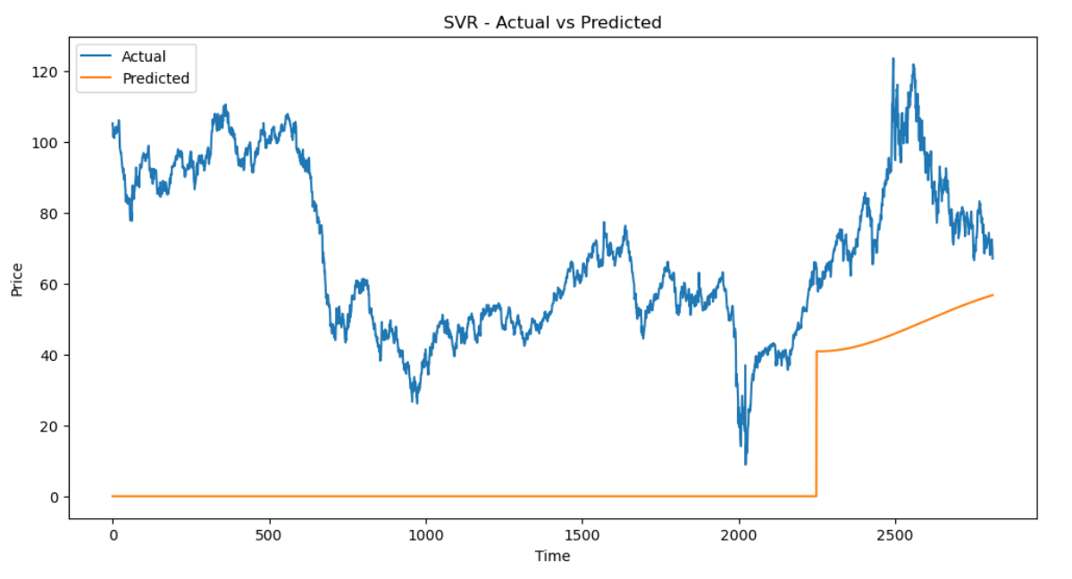
Support Vector Regression

Slide 22
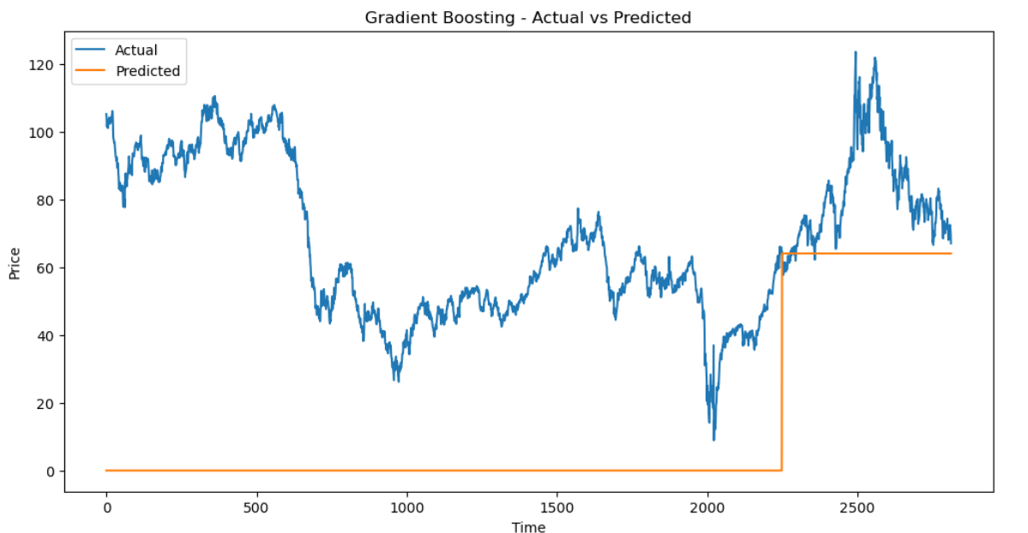
Gradient Boosting

Slide 23
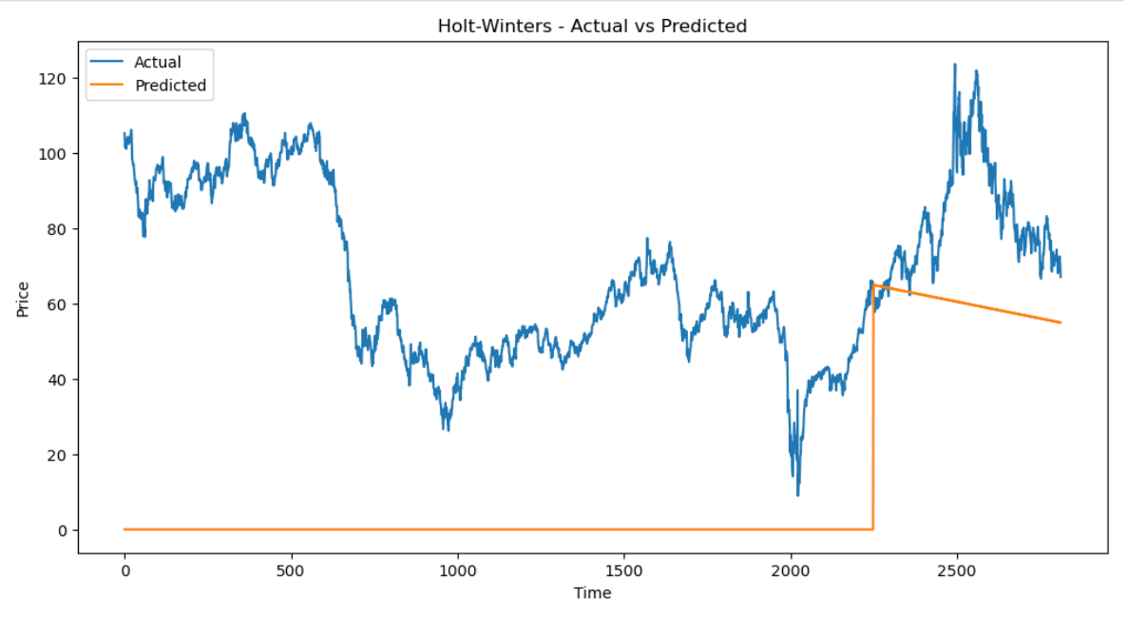
Holtwinters

Slide 24

ARIMA

Slide 25
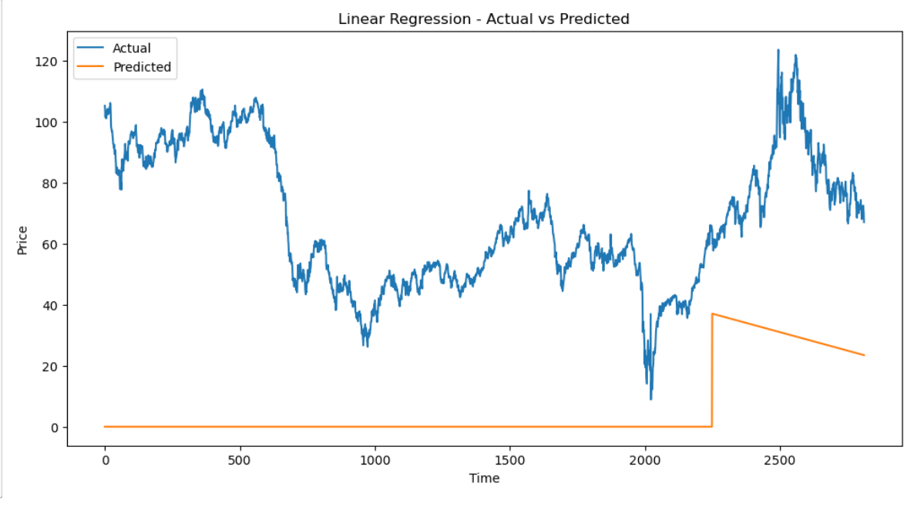
Linear Regression

Slide 26
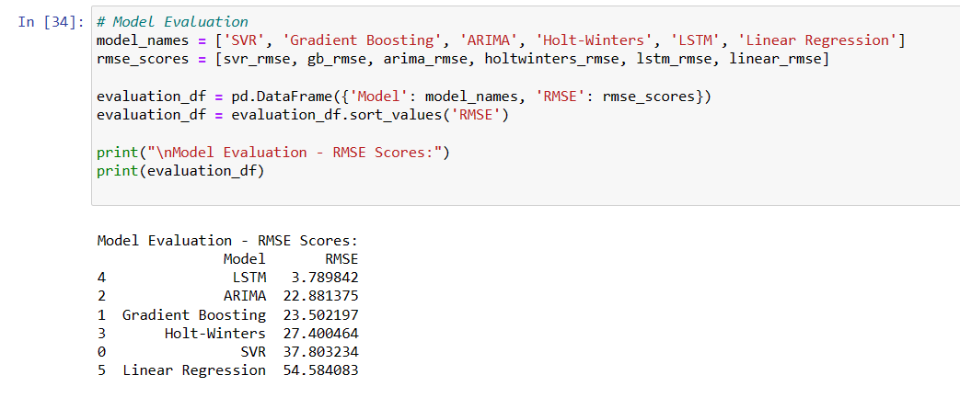
Model’s Evaluation

Slide 27
Final Model = LSTM
Gradient Boosting: This model achieved an RMSE score of 23.502197, indicating moderate accuracy in predicting the target variable.
ARIMA: The ARIMA model obtained an RMSE score of 22.881375, suggesting relatively better performance than Gradient Boosting.
Holt-Winters: With an RMSE score of 27.400464, the Holt-Winters model demonstrates slightly higher errors compared to ARIMA and Gradient Boosting.
LSTM: The LSTM model produced the lowest RMSE score of 3.789842, suggesting it has the best predictive accuracy among all the models evaluated.
SVR: The Support Vector Regression (SVR) model obtained an RMSE score of 37.803234, indicating higher errors compared to the previous models.
Linear Regression: The Linear Regression model performed the least accurately, with an RMSE score of 54.584083, indicating the highest level of prediction errors.
Conclusion
the LSTM model achieved the lowest RMSE score, indicating the best predictive performance. Therefore, it can be concluded that the LSTM model is the most suitable for the given task, as it provides the most accurate predictions compared to the other models.

Slide 28
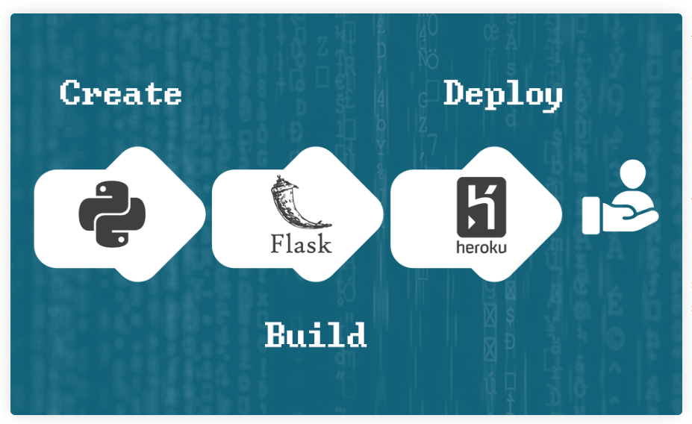
Model deployment using Flask

Slide 29
Deployment Of Model and User Interface
We implemented a machine learning model and made it available for practical use.
We designed a user-friendly interface to interact with the machine learning model.
We utilized Flask and HTML to develop the interface, ensuring simplicity and ease of use.
Our goal was to provide a straightforward and intuitive experience for users.

Slide 30
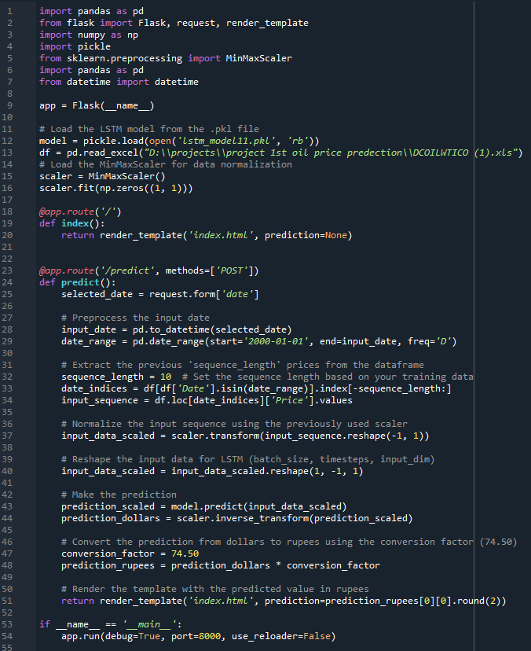
Flask code to create simple user interface
We use this Flask code to run an HTML page for users so that anyone can easily access and use our resources.

Slide 31
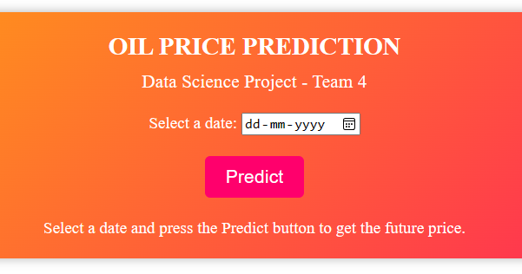


Simple User Interface
We created a user-friendly interface where users can input a date, click the predict button, and instantly obtain the desired result.
Just select
Press
Get result

Slide 32
Challenges that we face
We are new to this field and face many challenges.
Coding is difficult for us, and we encounter numerous errors.
We make 7 to 8 attempts to get each model to work.
We try different models to solve the problem.
Deploying the model is a significant challenge for us.
Creating a web page without knowledge is tough.
We try writing Flask code multiple times but face errors in setting up a local server.

Slide 33
"Overcoming Challenges: How did we succeed?"
We complete our project with
Positive mindset and problem-solving approach.
Extensive research and resource utilization.
Effective teamwork and collaboration.
Seeking guidance and support from mentors.
Continuous learning and skill development.
Persistence and resilience in the face of setbacks.
Maintaining a determined and positive attitude.

Slide 34
"Expression of Gratitude for Successful Project Completion"
We successfully completed our project, and I want to express my gratitude to Kartik sir and my team members. I am also very thankful to the internet, YouTube, and Google, as they provided valuable resources that helped us complete our project on time.

Slide 35
Thank you

